Slide 1


FRAUD DETECTION & ANALYSIS (Healthcare)

Slide 2
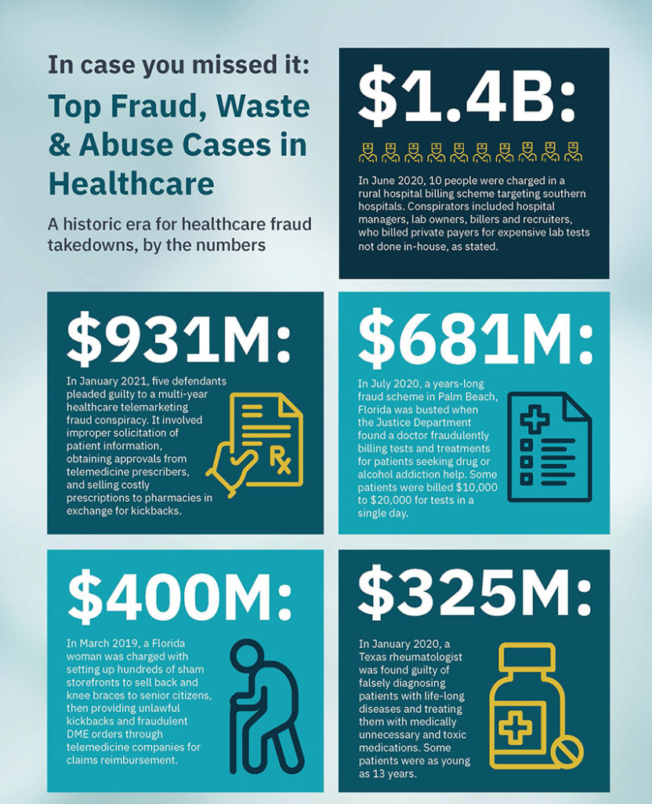

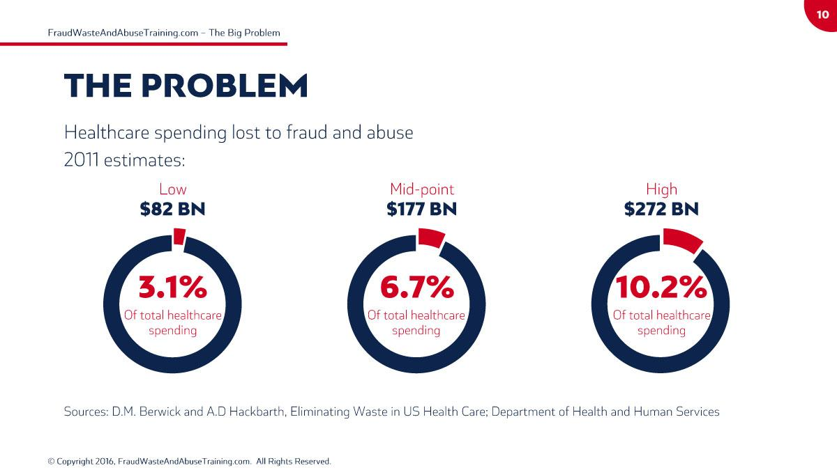



Healthcare Fraud: big role in recession.

Slide 3

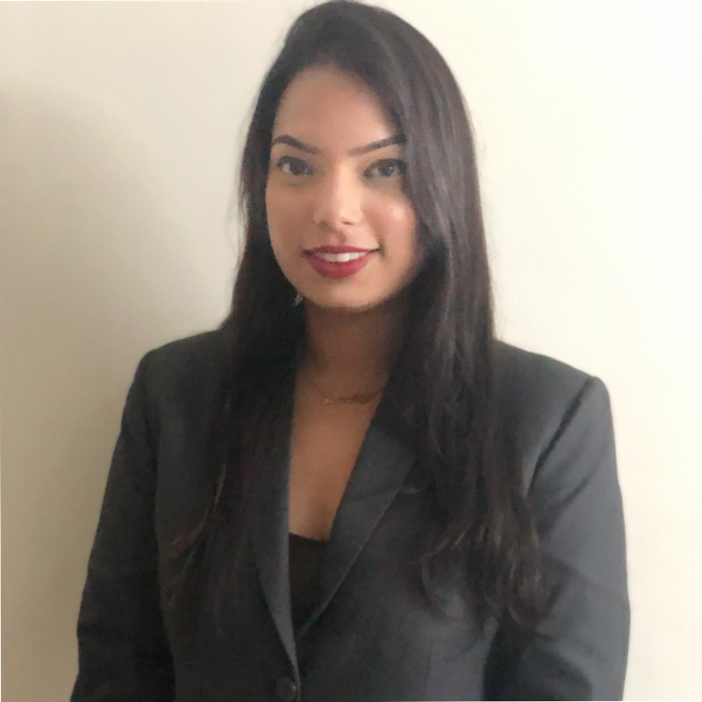
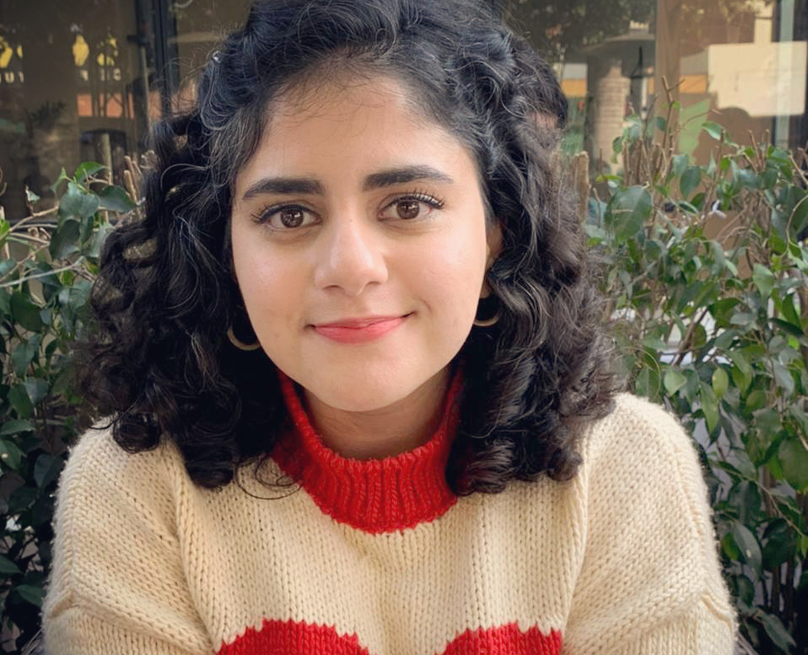
TEAM
ANANDITA MAURYA
SHAHLIZA ARSHAD
SONALI SINGH

Slide 4
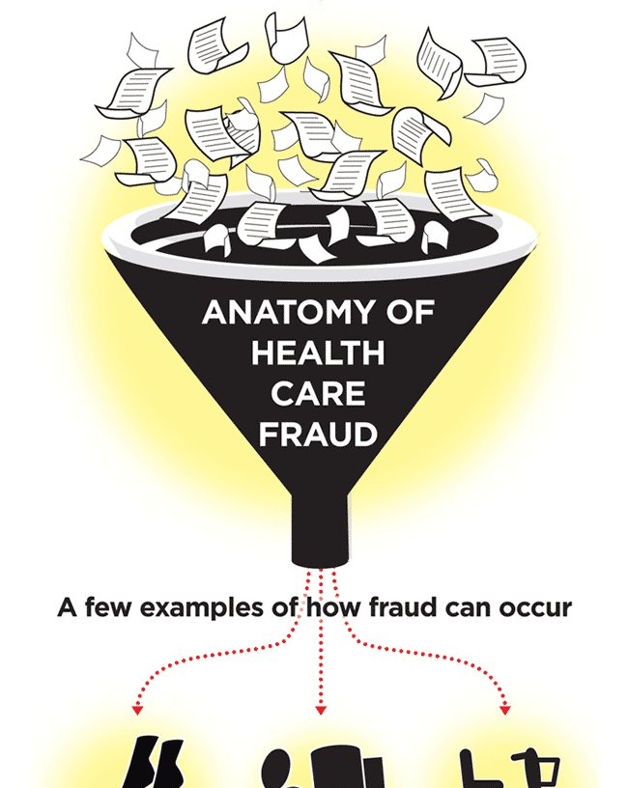
AGENDA
What is Healthcare exploitation: Fraud, Waste, Abuse.
Consequences of Fraud (Business Problem)
Our Potential Solution
Data Source, EDA, Preprocessing
Our Methods & Analysis
Prevention & Motivation - Conclusion
Questions ft. Suggestions

Slide 5
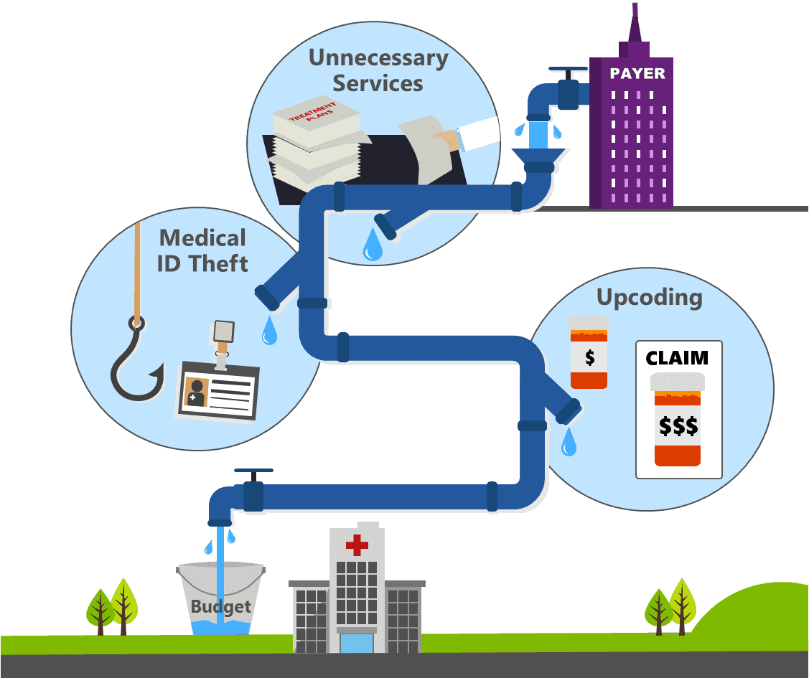
Healthcare Exploitation: Fraud, Waste, Abuse
Healthcare fraud and abuse take many forms. Some of the most common types of fraud by providers are:
Billing for services that were not provided.
Duplicate submission of a claim for the same service.
Misrepresenting the service provided.
Charging for a more complex or expensive service than was actually provided.
Billing for a covered service when the service actually provided was not covered.

Slide 6
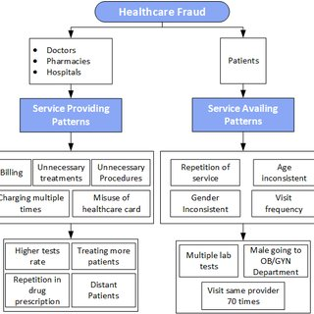

Slide 7
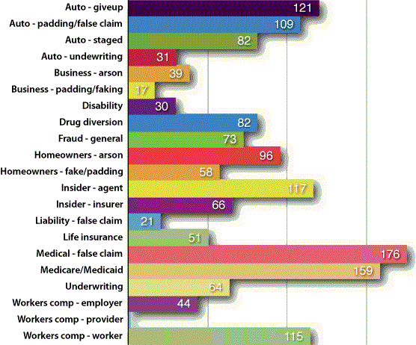
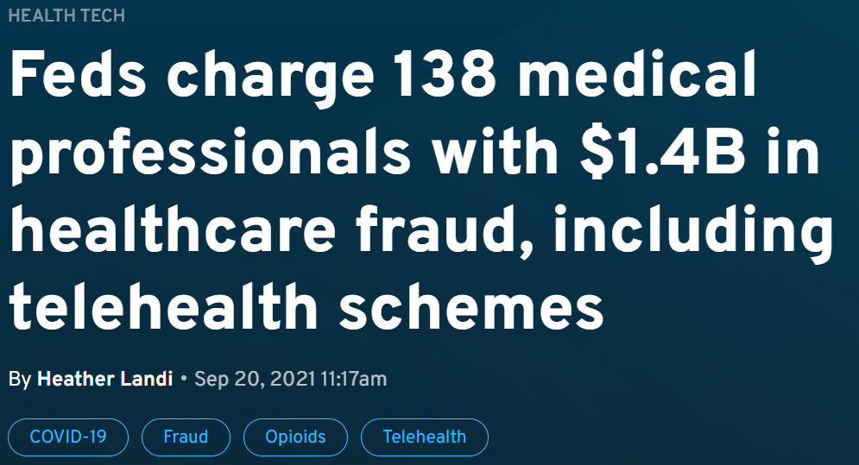
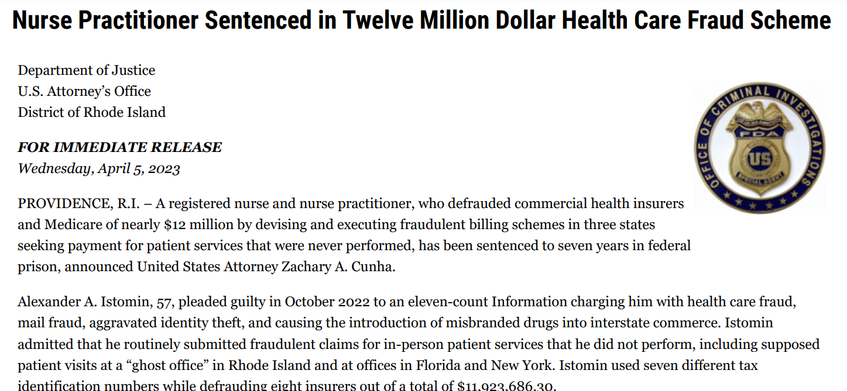
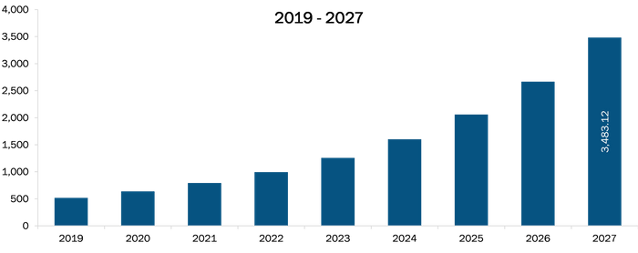
Fraud prevention: Highest priority of all.

Slide 8
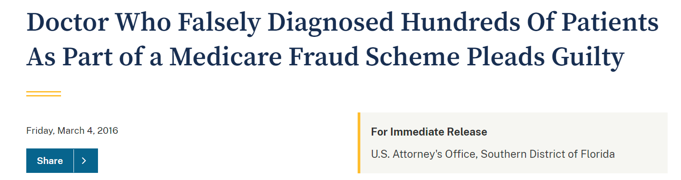
Highlighting the Shark’s

Slide 9
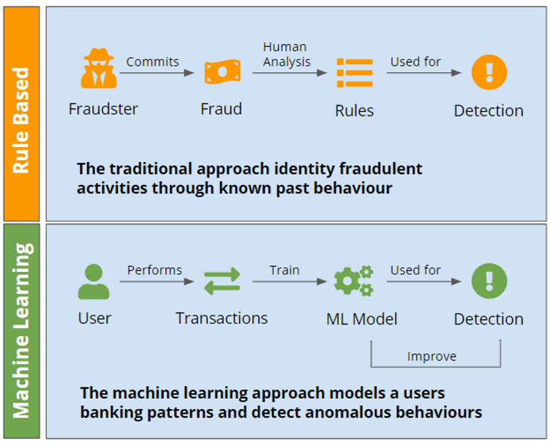
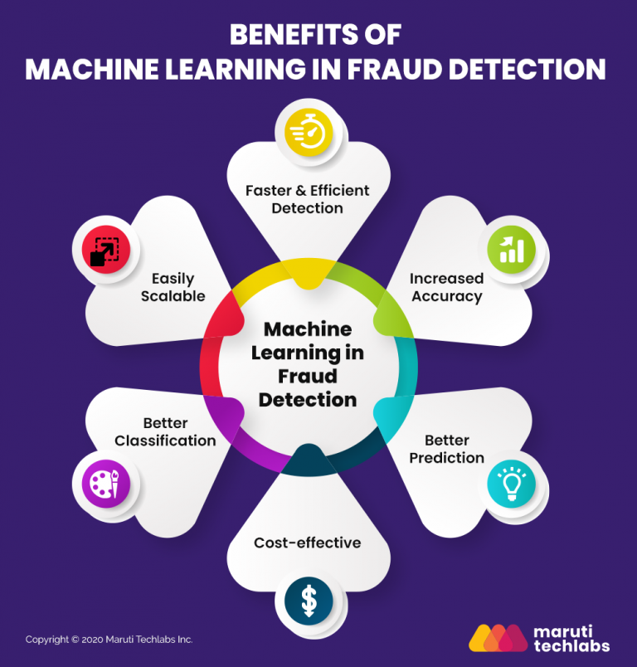
Approach : Predict potential Fraud

Slide 10
Data Source
Provider: Unique identifier for each provider in the dataset
BeneID: Unique identifier for each beneficiary in the dataset
ClaimID: Unique identifier for each claim in the dataset
Claim Amount Reimbursed : the amount credited to the patient post claim
Provider Health insurance Dataset
Source: Kaggle
Location: USA
Publishing date: 2019
For the purpose of this project, we are considering:
A) Inpatient Data
B) Outpatient Data
C) Beneficiary Details Data
Deductible Amt Paid: Amount paid by the beneficiary as part of the deductible for the claim
Patient Type : in and out categorised as per status of admission.
Gender, Race, State, County: It contains the Gender, Race, State,Country of the beneficiary
ChronicCond_Depression: Indicator for whether the beneficiary has depression (Y/N)
ChronicCond_Diabetes: Indicator for whether the beneficiary has diabetes (Y/N)
ChronicCond_IschemicHeart: Indicator for whether the beneficiary has ischemic heart disease (Y/N)

Slide 11
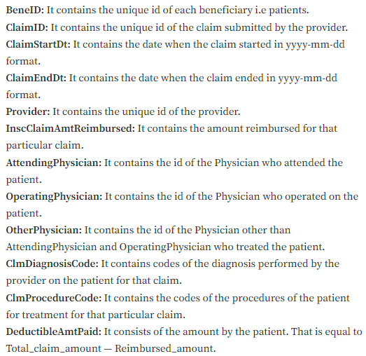
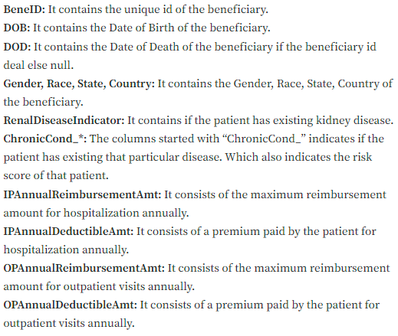
Detailed Dictionary:

Slide 12
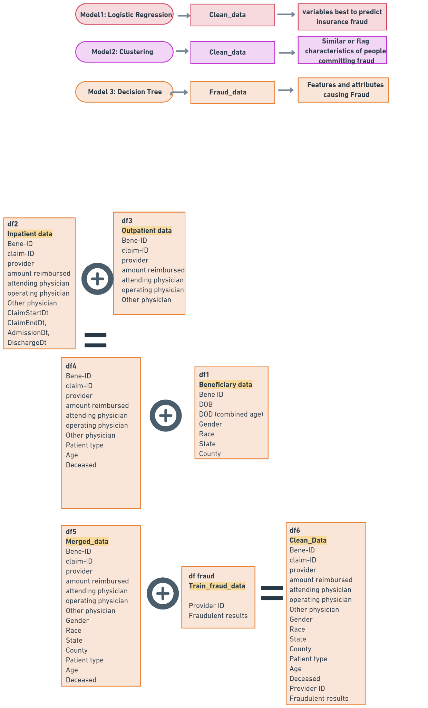
Data Pre-processing

Slide 13
Methods & Models

Slide 14
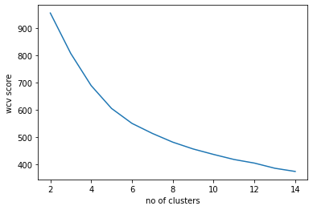
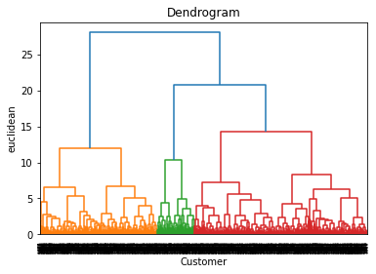
Clustering
Performed a clustering analysis of only Fraudulent Beneficiaries, to understand their characteristics better.
K-mean Clustering
Hierarchical Clustering

Slide 15
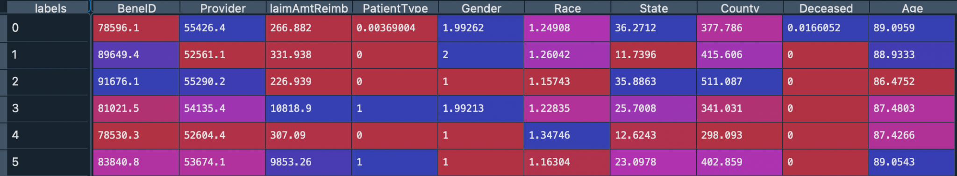
Clustering Results
Number of Clusters = 6
Cluster 1 | Admitted females in their 80s with lethal health disease requiring little reimbursement
Cluster 2 | Out-patient females in their 80s, not close to death, requiring little reimbursement
Cluster 3 | Out-patient males in their 80s, not close to death, requiring little reimbursement
Cluster 4 | Admitted males in their 80s, not close to death, requiring a lot of reimbursement (above 10,000$)
Cluster 5 | Out-patient males in their late 80s , not close to death, requiring little reimbursement
Cluster 6 | Admitted males in their late 80s, not close to death, requiring a lot of reimbursement (above 9000$)

Slide 16
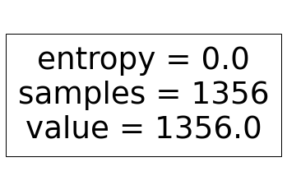
Decision Tree
Each decision tree gave us a probability of a claim being fraudulent or not
We trained our decision tree on random forest.
This is a special case with single leaf node (fraud only) so no need to perform splits as samples from the same class.

Slide 17
Logistic Regression
Final Dataset:
Beneficiary ID
Claim ID
Provider ID
Claim Amount Reimbursed
Patient Type
Gender
Race
State
County
Deceased
Age
Potential Fraud
558,211 observations
70:30 split
Train Set:
Test Set:
390747 obs
167464 obs

Slide 18
Predictor variables in this dataset using Forward Feature Selection
We saw that the relevant variables has a positive coefficient.
Insurance claim reimbursement amount
Patient Type (In / Out)
Gender (Male / Female)
Age
Deceased
*It is important to note that these variables are not true in general. It is just the predictors based on the data that was used for this regression analysis ONLY. If we use the same code for another provider, the results might differ.

Slide 19
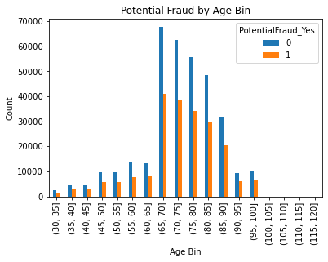
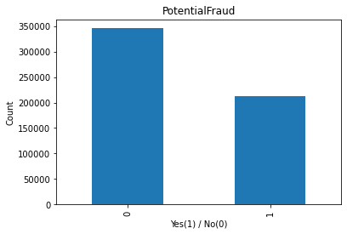
Our finding in this data

Slide 20
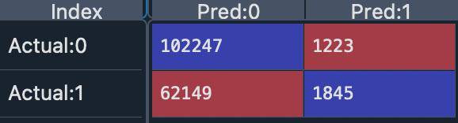
Confusion matrix
*As the dataset in healthcare fraud is highly imbalanced (very few fraud cases), ‘accuracy’ metric won’t be proper.
Accuracy Score – 62.16%

Slide 21
Limitations
We found good predictors such as state, county, race, etc. for potential fraud however the categorical number description is not given for them.
Dataset was very big and the kernel of python was stopping very frequently.

Slide 22
THANK YOU
Question?
Suggestions

